Slide 1

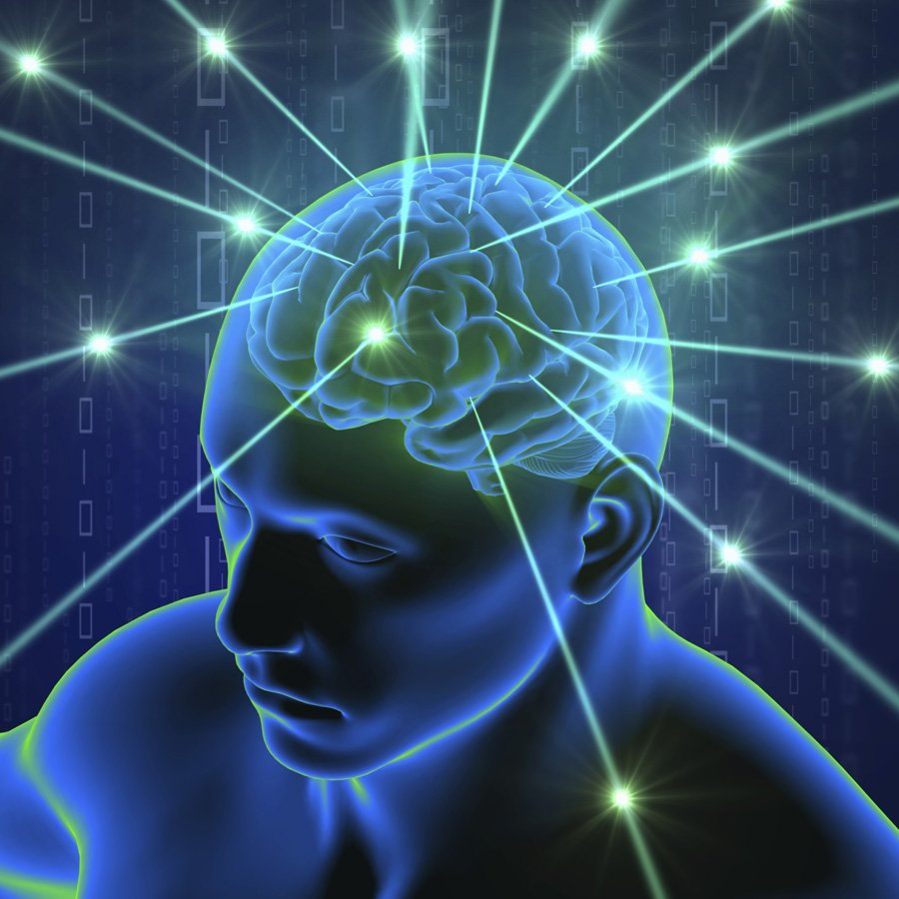
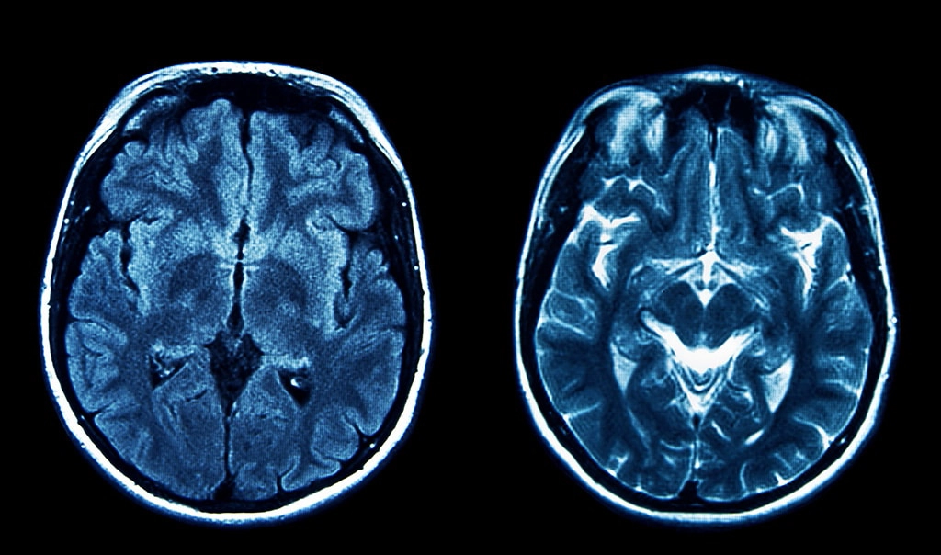
CDANET Redefined
By Aparna Sajith, Cole Sottile, Jovita Chang

Slide 2
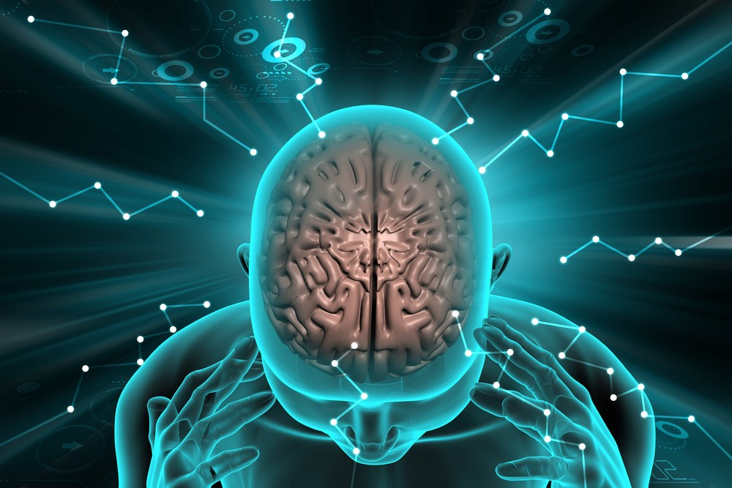
CDANET - Quick Reintroduction
CDANET was proposed by Tapas Kumar Dutta & Deepak Ranjan Nayak
Tapas Kumar Dutta Credentials: Department of IT, Indian Institute of Engineering Science and Technology
Deepak Ranjan Nayak Credentials: Department of CSE, Malaviya National Institute of Technology
CDANET is a convolutional neural network
Uses CSDA Modules to effectively examine MRI scans and identify brain tumors
Also Uses a channel split dual attention mechanism for more accurate results as shown in the prior paper.
The goal of the authors is able to identify tumours with minute variations.

Slide 3
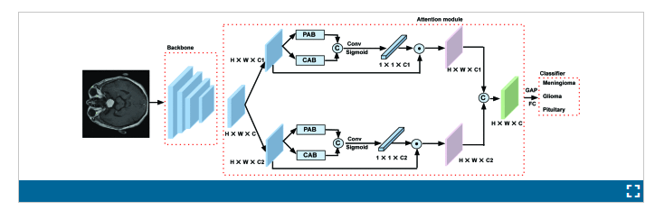
CDANET - Architecture

Slide 4
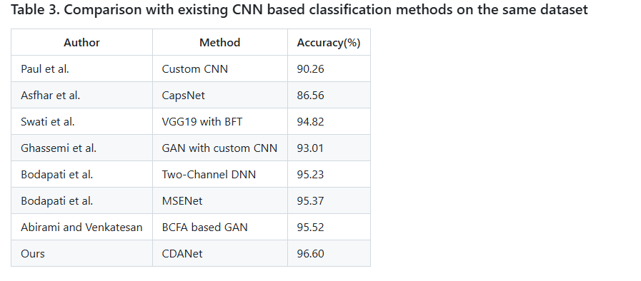
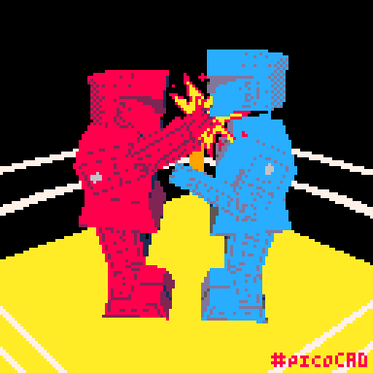
CDANet vs Other Models (cont.)

Slide 5
CapsNet
Capsule Networks (CapsNets) are a special kind of neural network that tries to better capture hierarchical relationships
Instead of using regular neurons, CapsNets use capsules, which are groups of neurons working together
Each capsule doesn't just say "something is here" (like normal neurons); it also captures where it is and how it looks (its pose, size, orientation, etc.)
Capsule Networks were created because traditional methods like max-pooling throw away too much important information when trying to make the network recognize things at different positions or scales.
CapsNets represent features as vectors, where the length of the vector indicates the probability of a feature's presence, and the direction encodes its pose or orientation. This allows CapsNets to learn more robust representations of objects and their relationships, particularly in the presence of affine transformations like rotations, translations, and scaling.

Slide 6
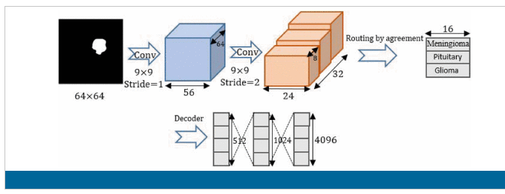
CapsNet Architecture

Slide 7
VGG19 with BFT
VGG with block-wise fine-tuning is a pre-trained convolutional neural network with 19 layers (a series of convolutional and max pooling followed by fully connected layers) and 144 million trainable parameters.
Early layers extract low-level simple structural features like edges and textures, while deeper layers capture high-level, domain-specific abstractions by hierarchically combining these features.
The weights of CNN are initialized with pre-trained VGG19. Then block-wise fine-tuning is added. The VGG19 architecture is divided into six blocks based on pooling layers, since doing layer-wise fine-tuning for each of the 19 layers is too resource-intensive. During the training process, the weights of the CNN layers are updated after every iteration.
The CNN is then trained in a block-wise approach, starting the fine-tuning from the last block (high level features) and freezing the learning of all earlier blocks, fixing the low level blocks. The learning of the earlier layers can be frozen because of the low-level generic features in these layers.

Slide 8
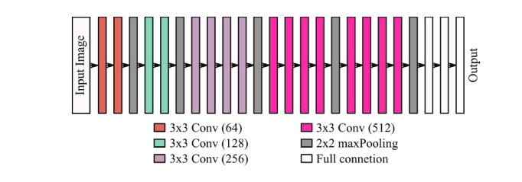
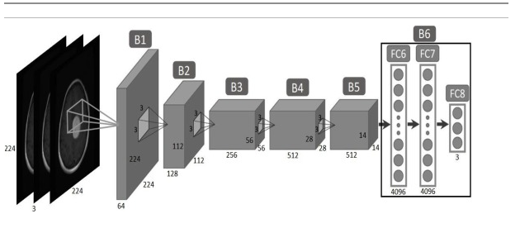
VGG19 with BFT Architecture

Slide 9
Two Channel DNN
Two channel DNN is a network designed on the fact it can take 2 different types of inputs. Uses 2 input modalities to process the images with a CNN Stack.
Once those channels finish preprocessing, they enter the fusion layer. The images are fused and concatenated together for better accuracy.
Once the fusion is complete, the prediction is made.
Good with diverse datasets and handles heterogeneity in appearances of the tumors.

Slide 10
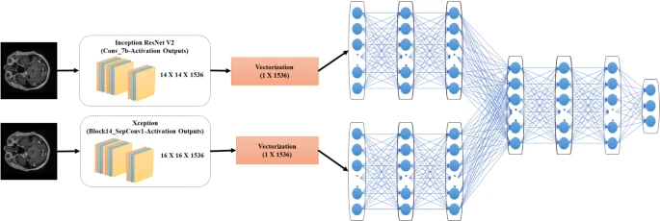
Two Channel DNN Architecture

Slide 11
MSENet
MSENet is another model which capitalizes on its ability to take multi-modal input. What that means is it can handle multiple different types of tumor images to find aspects of the data that almost no other model can find.
It comes from its distinct Squeeze-and-Excitation blocks. These blocks work as attentions mechanisms and allow the program to focus on certain small areas.
The squeeze is a compression tool to compress the dimensions of each feature map and apply global average pooling, results in a vector.
The excitation step is the resulting vector passed into a smaller neural network with reLU and sigmoid activation functions.
The way the model is made makes it have very minimal preprocessing time and doesn’t need to rely on them.

Slide 12
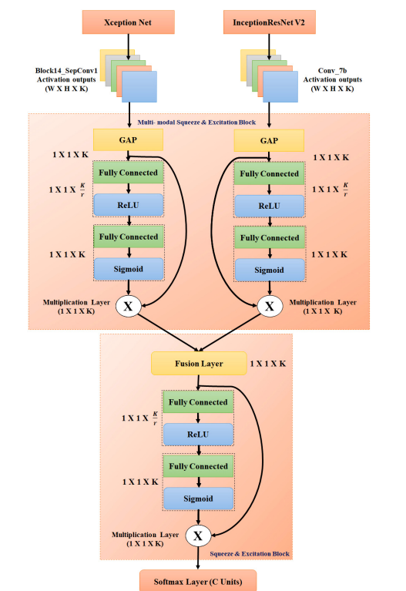
MSENet Architechture

Slide 13
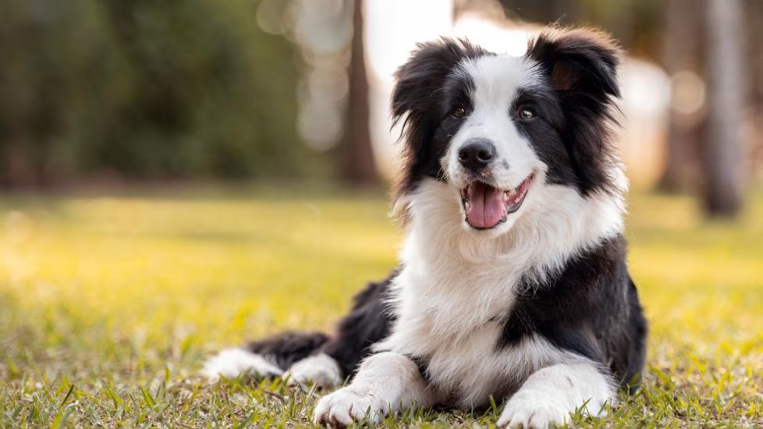
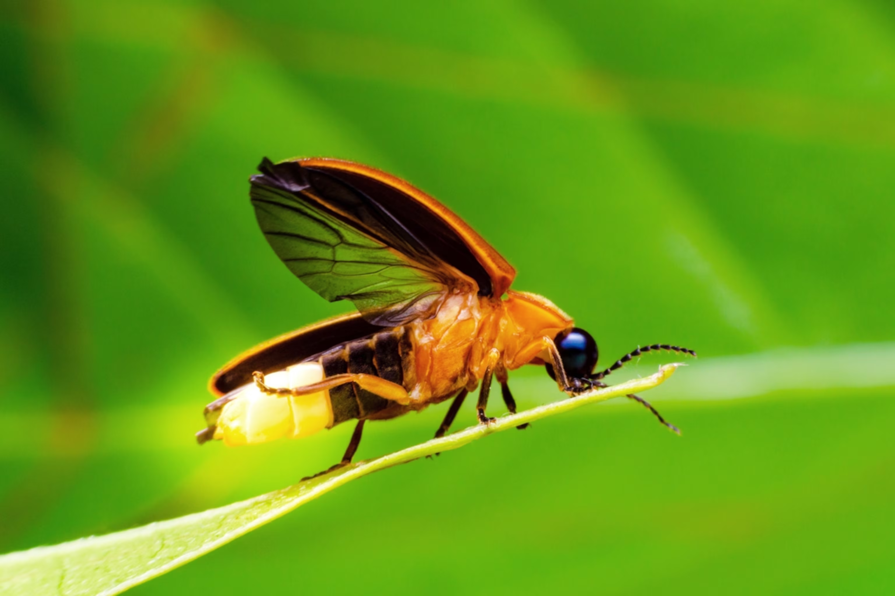
BCFA Based GAN
Border Collie Firefly Algorithm (BCFA) based GAN is an enhanced generative network. It works by using a spark framework.
The main appeal is the multiple slave nodes to handle processing in parallel. The nodes reconverge after running the image through the steps of preprocessing into a support vector machine to classify their severity.
Due to their increased optimization and distributed computing, it makes the model very robust and can deal with complex MRI scans.
It is very good at generalizability.

Slide 14
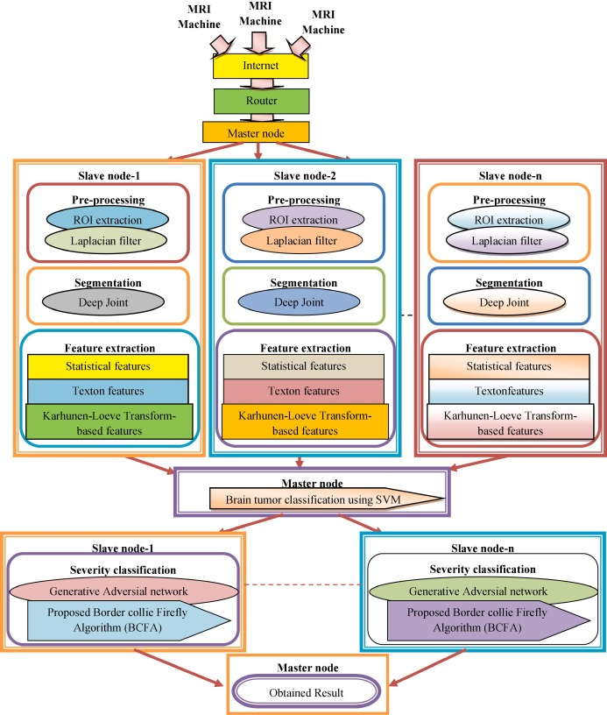
BCFA Based GAN Architecture

Slide 15
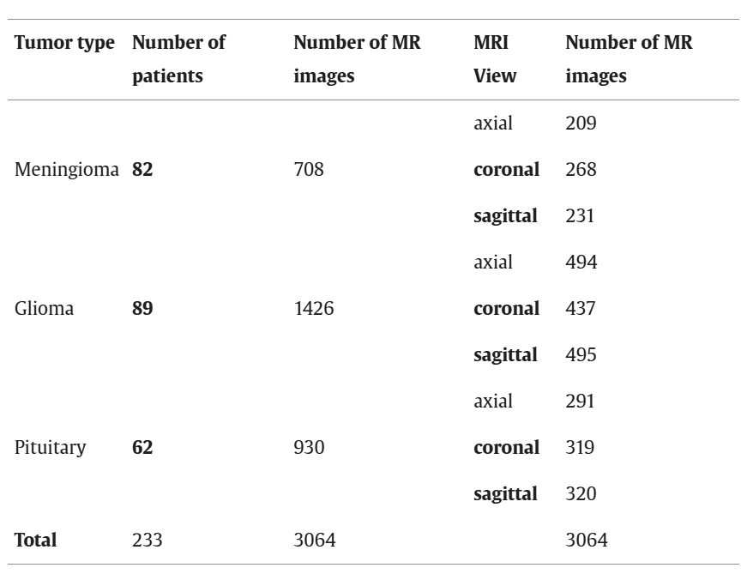
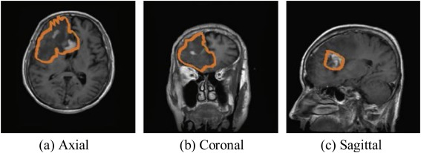
CE-MRI DataSet
The images in the dataset are provided in matrix form. The size of each image is 512 × 512
3064 images across the axial, coronal, and sagittal views.

Slide 16
CBAM - Attention Mechanism Detailed in Paper
Input Feature Maps: CBAM takes feature maps of shape (batch, channels, height, width).
Channel Attention Module:
Applies global average pooling and global max pooling across spatial dimensions.
Both pooled vectors (shape: batch × channels) go through a shared MLP.
Outputs are added and passed through a sigmoid to get channel weights.
These weights are used to scale the original feature maps channel-wise.
Spatial Attention Module:
Takes the channel-refined feature map and applies max and average pooling across channels, producing two (batch × 1 × H × W) maps.
These are concatenated and passed through a 7×7 convolution followed by a sigmoid activation.
The result is used to scale the feature map spatially (element-wise across H × W).
So, CBAM first tells the model what to focus on (channels) and then where to focus (spatially).

Slide 17
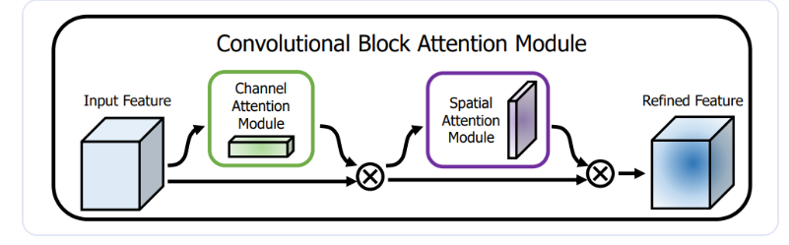
CBAM Architecture

Slide 18
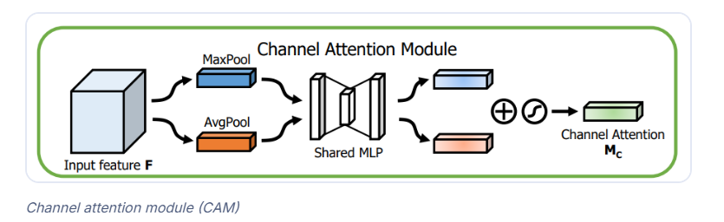
CAM in CBAM Architecture

Slide 19
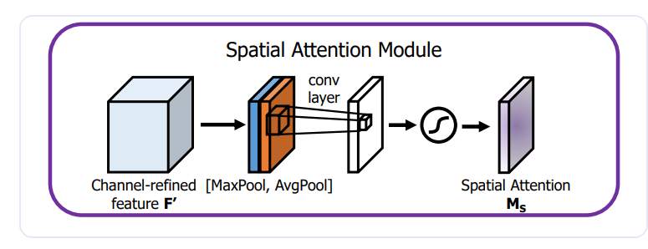
SAM in CBAM Architecture

Slide 20
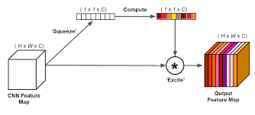
SE - Attention Mechanism Detailed in Paper
Input Feature Maps: SE blocks take feature maps shaped as (batch, channels, height, width).
Squeeze: Global average pooling compresses each channel into a single value, resulting in a (batch, channels) vector.
Excitation: This vector passes through two small fully connected layers with ReLU and sigmoid activations to learn channel-wise importance.
Recalibration: The original feature maps are scaled by these importance values, enhancing informative channels and suppressing less useful ones.

Slide 21
Proposed Attention Block Introduced in Paper
Input and Backbone: An MRI image is input to a pre-trained CNN (e.g., ResNet), and high-level feature maps are extracted from its last convolutional layer.
Channel Split Dual Attention Block (CSDAB): The feature map is split into two halves along the channel axis. Each half goes through two parallel attention modules:
Channel Attention Block (CAB) highlights important channels using global average pooling and two 1×1 convolutions with ReLU and sigmoid.
Position Attention Block (PAB) focuses on important spatial locations using cross-channel average pooling and spatial attention,
Attention Fusion: The outputs from CAB and PAB are concatenated and passed through a 1×1 convolution + sigmoid, then multiplied with the input to apply refined attention. Outputs from both halves are finally concatenated back into a single refined feature map.
Classifier: A global average pooling layer and a fully connected layer with 3 outputs classify the MRI as meningioma, glioma, or pituitary tumor.

Slide 22
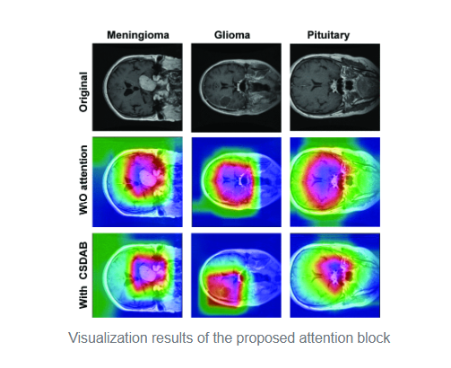
Proposed Attention Block Visualization Results

Slide 23
Tested ImageNet CNN
The authors of the paper tested the architecture of the paper with the following pre-trained backbone networks
DenseNet-121
MobileNet
ResNet-50
Squueeze Net
EfficientNet B0
However with all of these models, we were able implement a few of the noted models. With recent developments in image detection, we decided to test out our possible architecture using transformers, newer pre-trained backbone networks, and feature pyramid networks that were introduced later on than that of the publication of the article in this case. Our primary focus throughout the project was to improve the architecture of the proposed CDANet as well as learning various deep learning advancements.

Slide 24
Feature Pyramid Networks
Backbone Feature Extraction - A standard CNN (e.g., ResNet) is used as the bottom-up pathway, producing a hierarchy of feature maps at different spatial resolutions.
Top-Down Pathway - High-level (semantic-rich) features from the top layer are upsampled step by step to match the resolution of lower-level feature maps.
Lateral Connections - At each level, the upsampled feature is fused (via element-wise addition) with the corresponding feature map from the bottom-up path (e.g., C4, C3, etc.) after applying a 1×1 convolution to match channel dimensions.
Feature Pyramid Output - This results in a set of enhanced, semantically rich multi-scale feature maps (e.g., P2, P3, P4, P5) with different resolutions, each suitable for detecting or segmenting objects at various scales.FPN is widely used in object detection and segmentation tasks because it preserves spatial details while injecting high-level context into all scales.

Slide 25
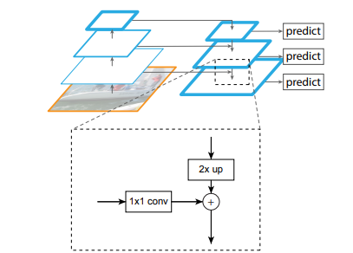
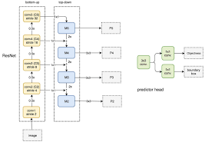
Feature Pyramid Networks
Each feature map processed by a 1x1 conv to reduce the number of channels.
Higher-level features are upsampled by 2x spatially and added to the lower-level features to combine semantic and spatial information
Can detect objects at multiple scales
Notes:
Each feature map is first processed by a 1×1 conv to reduce the number of channels.
This helps unify the feature dimensions across different levels.
Multiple feature maps at different levels, different spatial resoultions, top-down

Slide 26
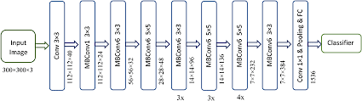
First Implementation of Code
In our very first approach, we explored creating a model with the following specifications:
Replaces DenseNet121 with EfficientNet-B3 for a more efficient feature extractor
Offers better scaling properties with ~12M parameters compared to DenseNet's 8M
Maintains compatibility with existing dual-path attention structure
We could therefore maintain the inclusion of an ImageNet pretrained backbone network.

Slide 27
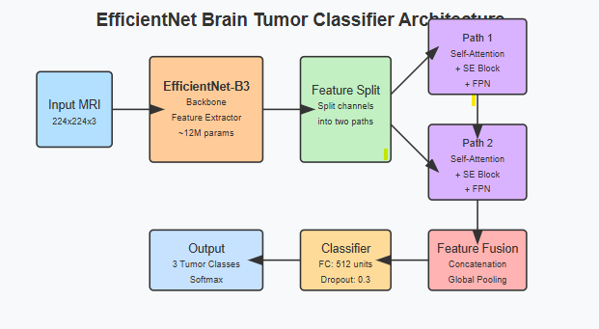
Code Architecture

Slide 28
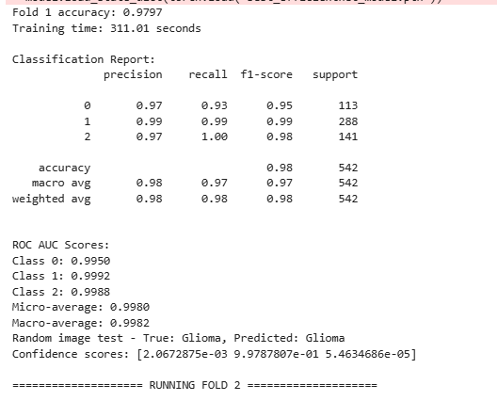
Loss Curve - Fold 1

Slide 29
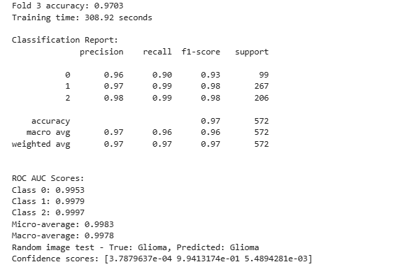
Loss Curve - Fold 3

Slide 30
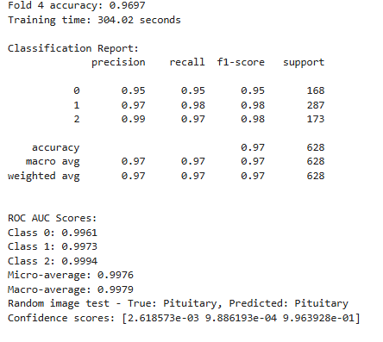
Loss Curve - Fold 4

Slide 31
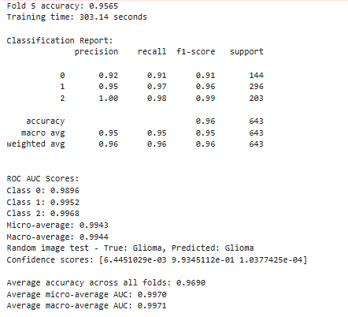
Loss Curve - Fold 5

Slide 32
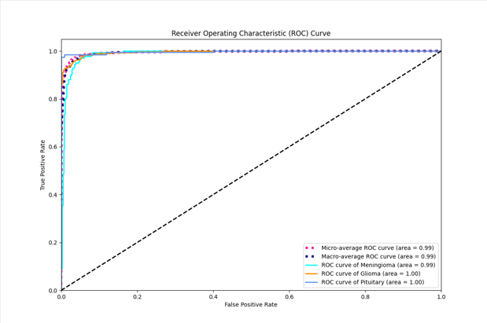
ROC Curve

Slide 33
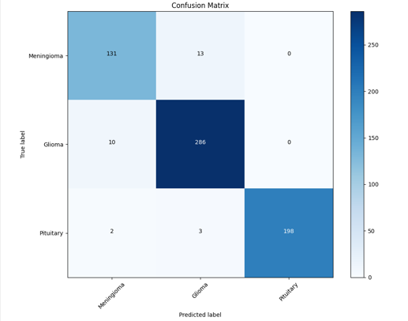
Confusion Matrix

Slide 34
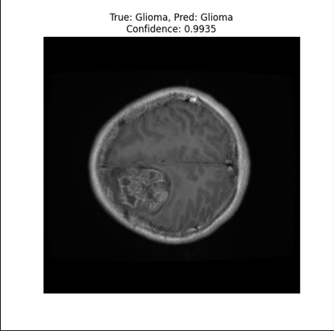
Sample Test Image

Slide 35

Demo of the Code
Bandicam wouldn't let me record more than 10 minutes, so there maybe occasional cuts

Slide 36
Second Implementation of Code
The enhanced EfficientNet architecture combines a powerful EfficientNet-B4 backbone with dual-stream attention mechanisms to capture diverse feature representations of brain tumor images. Each stream utilizes specialized attention blocks (either Self-Attention, CBAM, or Dual Path) alongside Squeeze-and-Excitation modules to emphasize important feature channels while suppressing less relevant ones. Feature Pyramid Networks in each stream enable multi-scale feature extraction, after which the streams are combined and passed through global context blocks to capture long-range dependencies before classification. This architecture effectively balances computational efficiency with sophisticated attention mechanisms to create a robust brain tumor classification system that can distinguish between Meningioma, Glioma, and Pituitary tumors.

Slide 37
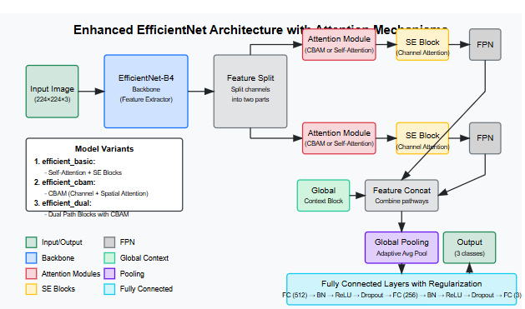
Code Architecture

Slide 38
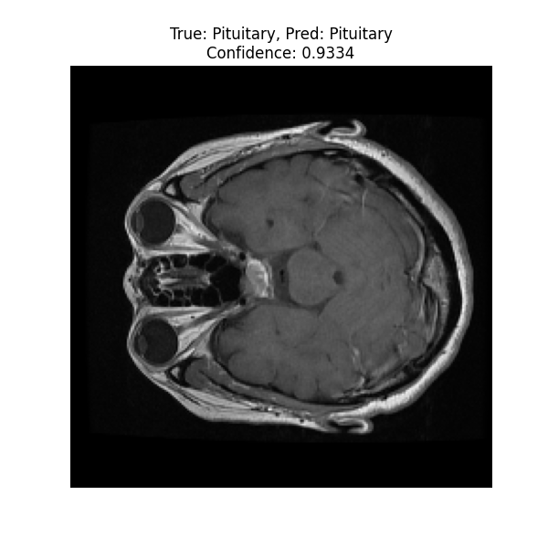
Random Test of EfficientNet

Slide 39
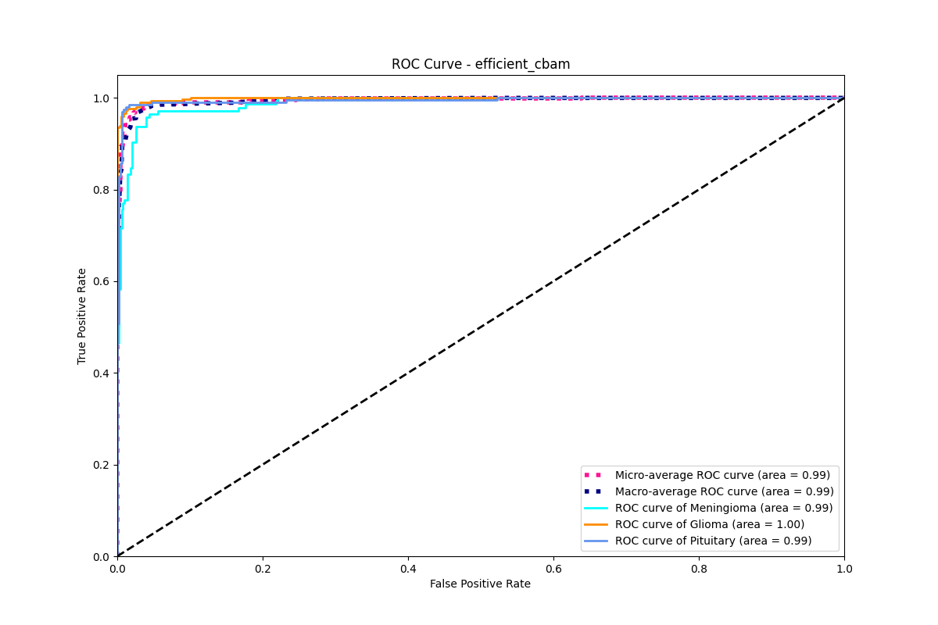
ROC Curve - Efficient CBAM

Slide 40
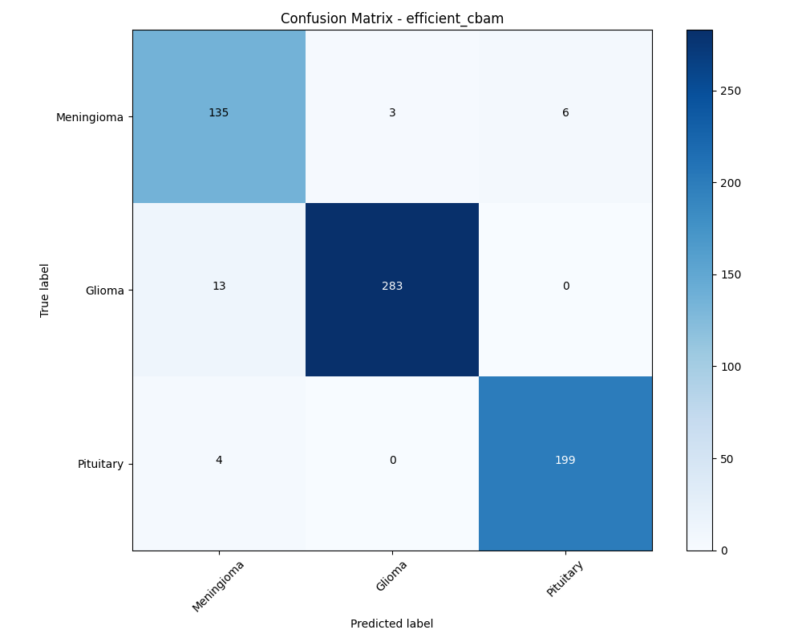
Confusion Matrix - Efficient CBAM

Slide 41
Updated Architecture
Backbone - DenseNet121
Outputs 1024 feature map
Dual Attention Block
Splits into two blocks with 512 channels each
Processed in parallel
Consists of
Transformer block
SE Block
Coordinate Attention
FPN Module - feature pyramid
Feature Fusion
Classification

Slide 42
Second Demo of Code

Slide 43
Conclusion
We decided to try to understand more of deep learning. We wanted to optimize the CDANET architecture, but we had a small margin to outperform. The base accuracy to beat was 96.60% and we managed to beat it by 0.37%. This is sadly not very much, but with such a high baseline there was only so much we could do to further enhance the results. With FPN and EfficientNet, we saw improvements to the original architecture and a little boost to performance. We really didn’t want to jump to straight to Decoder-Encoder architecture or even just using Transformer for better accuracy.
Our ideas to further this model along to get the accuracy up would be either to add a swin-t transformer to the architecture or incorporate a U-net base transformer. We believe that would further increase results. We would furthermore need to perform and ablation study to better determine the best approach to improve the architecture of the model.

Slide 44
References
https://ieeexplore.ieee.org/document/9897799
https://www.geeksforgeeks.org/capsule-neural-networks-ml/
https://www.sciencedirect.com/science/article/abs/pii/S1746809422000568
https://www.sciencedirect.com/science/article/abs/pii/S1746809422001665?casa_token=1v8p_XosgOoAAAAA:7td_l3bCIvEETLVHqzaKsTyJL838V2h6RI6j2GbB5J2vqdLsQnzrGeJIadh3ZYZeeK3lClovcQ#s0020
http://hdc.cs.arizona.edu/~mwli/understanding-capsule-network/writing/
https://link.springer.com/article/10.1007/s12652-020-02568-w
https://www.kaggle.com/datasets/ashkhagan/figshare-brain-tumor-dataset/data

Slide 45
References Continued
https://openaccess.thecvf.com/content_cvpr_2018/papers/Hu_Squeeze-and-Excitation_Networks_CVPR_2018_paper.pdf
https://www.sciencedirect.com/science/article/pii/S0895611118305937
https://openaccess.thecvf.com/content_cvpr_2018/papers/Hu_Squeeze-and-Excitation_Networks_CVPR_2018_paper.pdf
https://paperswithcode.com/method/swin-transformer
https://arxiv.org/abs/2103.14030v2
https://arxiv.org/abs/1911.07968
https://pytorch.org/vision/main/models/generated/torchvision.models.efficientnet_b3.html

Slide 46
References Continued
https://arxiv.org/pdf/1905.11946
https://huggingface.co/google/efficientnet-b3
https://arxiv.org/abs/1612.03144
https://scikit-learn.org/stable/modules/cross_validation.html
https://www.datasciencecentral.com/roc-curve-explained-in-one-picture/
https://link.springer.com/article/10.1007/s11760-020-01793-2
https://jonathan-hui.medium.com/understanding-feature-pyramid-networks-for-object-detection-fpn-45b227b9106c
https://openaccess.thecvf.com/content_cvpr_2018/papers/Hu_Squeeze-and-Excitation_Networks_CVPR_2018_paper.pdf

Slide 47

THANK YOU!
Questions?

